Slide 1

Time Series Data Analysis
Kushum K C

Slide 2
Time series analysis
Preprocessing of the data
Identifying missing data - time series continuous dataset
Fill/Impute missing data
Kalman Filter (fit model and extrapolates instead of interpolation of missing data
Visualization of plot for any trends
ACF, PACF – within a dataset
Cross Correlation – for multiple datasets
Understanding the possible trends and patterns using various test
First check for the disturbance within the data
Perform Man Kendal test for trend analysis
Perform Augmented Dickey Fuller test for stationarity

Slide 3

Data sets
Three Daily Level Historical Datasets
J-17 Well (Edward Aquifer) Dataset (1932/11/12 to 2023/03/02)
Comal Spring Discharge (1927/12/19 to 2023/04/16)
San Marcos Spring Discharge (1956/05/26 to 2023/04/14)
Data downloaded from
https://www.edwardsaquifer.org/science-maps/aquifer-data/historical-data/
Time period of data collection is different, and the parameters measured are different.
For J-17 Well Data: Date and Water Level Elevation (ft)
For Comal Spring Discharge: Date and Spring Discharge (cfs)
San Marcos Spring Discharge: Date and Spring Discharge (cfs)

Slide 4
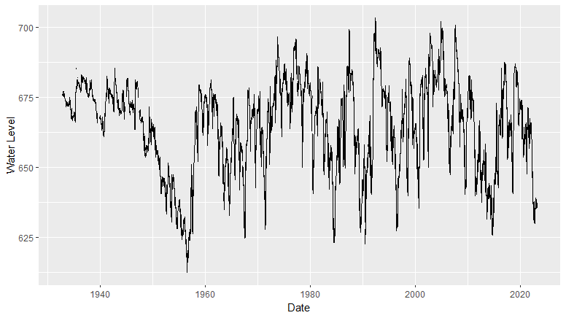
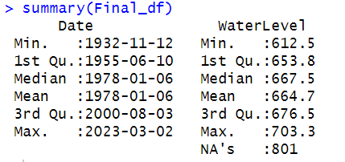
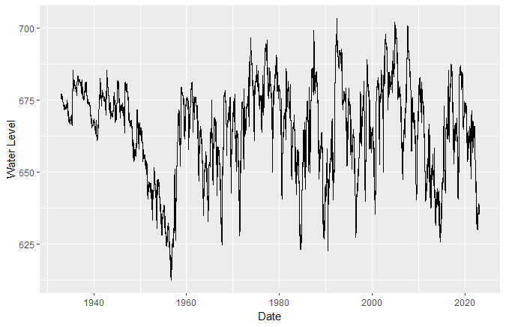
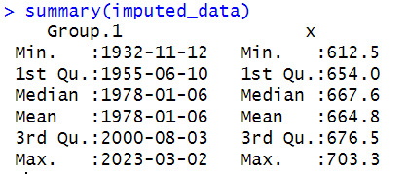
J_17 Well Datset
Original dataset with missing values
Imputed dataset with extrapolated values

Slide 5
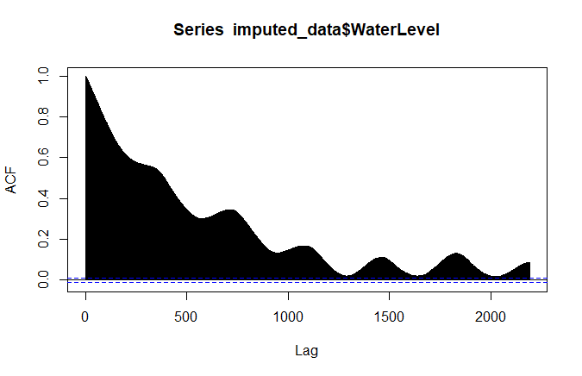
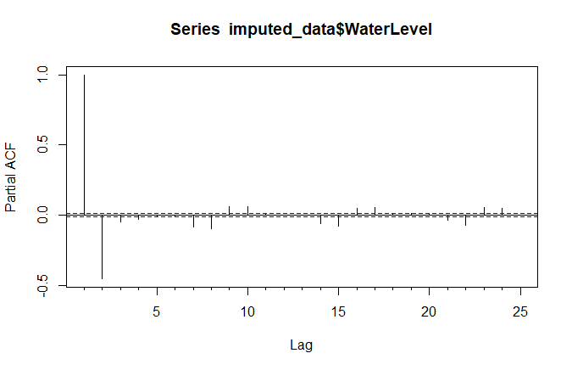
Auto Correlation (ACF) and Partial Auto Correlation (ACF) of Imputed data
Auto-Correlation for J-17 well
Partial Auto-Correlation for J-17 well

Slide 6

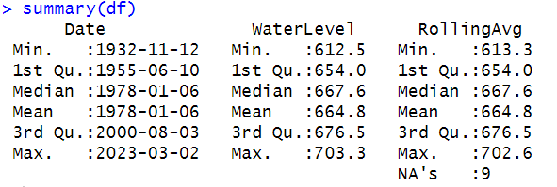
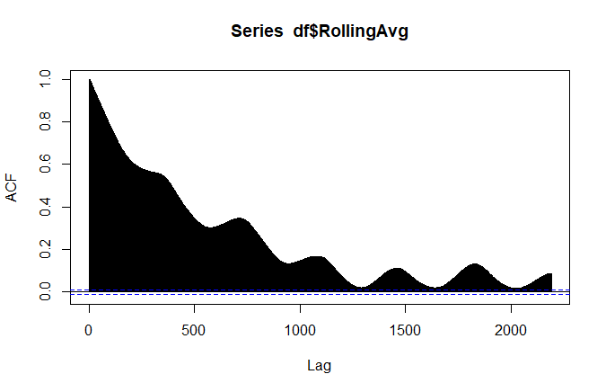
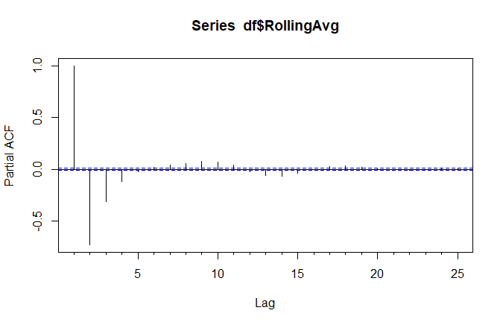
Rolling Average
To smoothen the variability present in the dataset
10 days Rolling Average

Slide 7
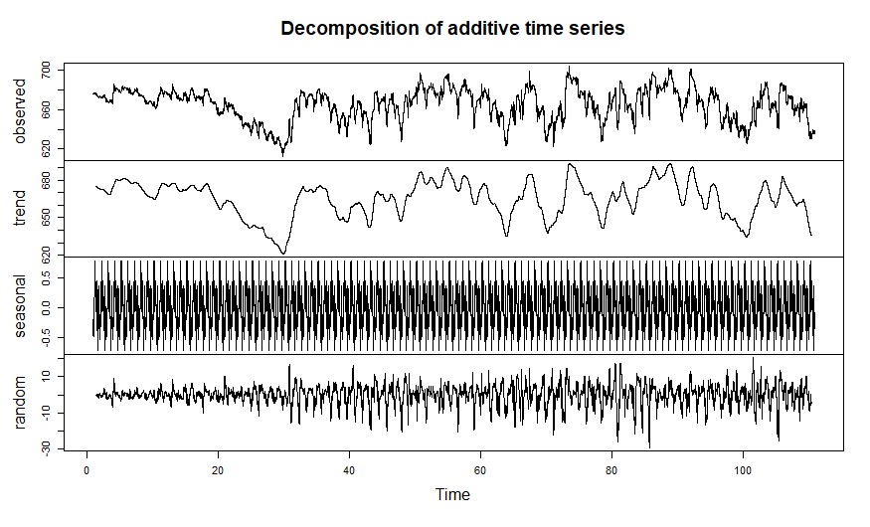
Time Series Decomposition

Slide 8
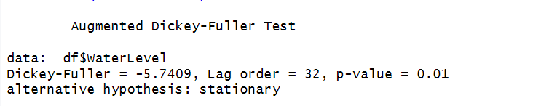
Data Test in Time Series
Mann-Kendall test
Useful for analyzing the change over a period in a long run time
Assumptions: Data doesn't have any trend as Null Hypothesis
Two tailed P-test done for analysis:
p-value is less than 0.05, then reject the null hypothesis of the test
There is some trend present in the data.
Augmented Dickey- Fuller Test
Assumption:
Null hypothesis : the time series is non-stationary (has a unit root)
Alternative hypothesis is that the time series is stationary.

Slide 9
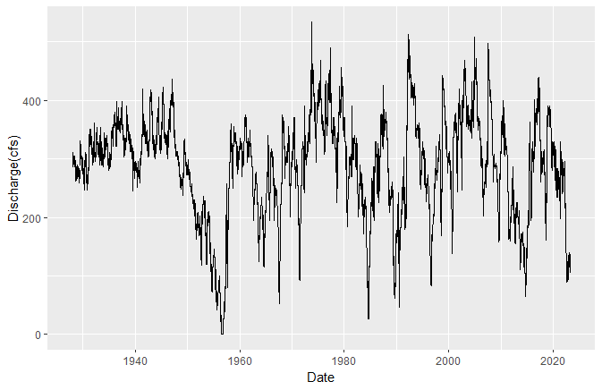
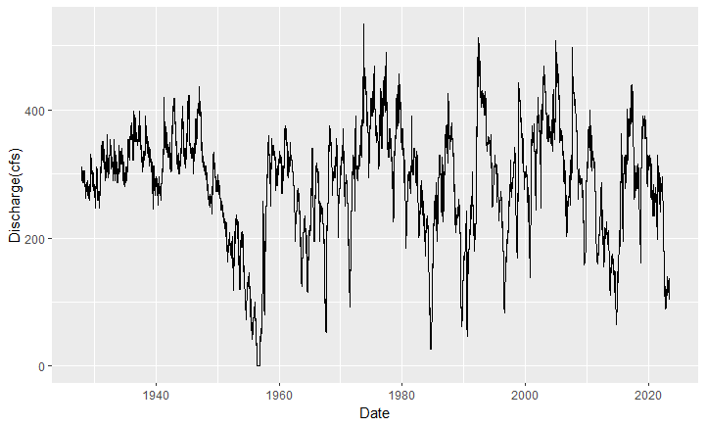
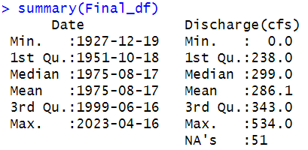
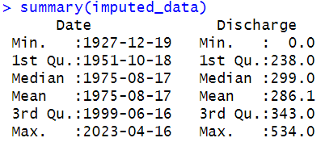
Comal Spring discharge
Original dataset with missing values
Imputed dataset with extrapolated values

Slide 10
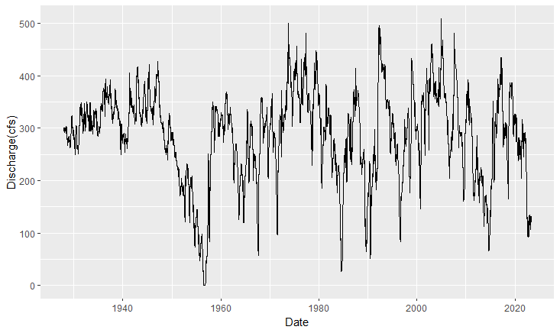
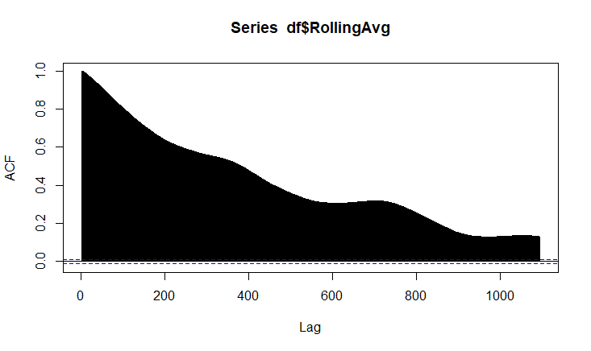
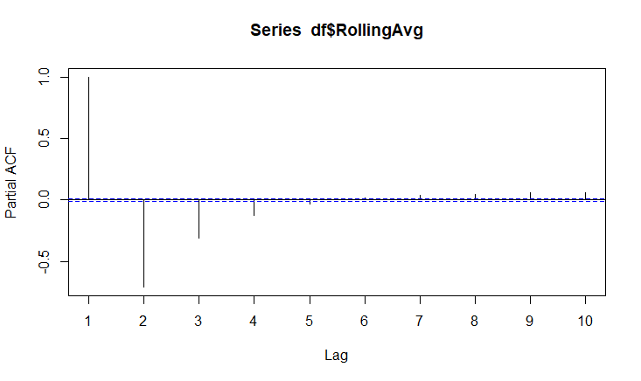
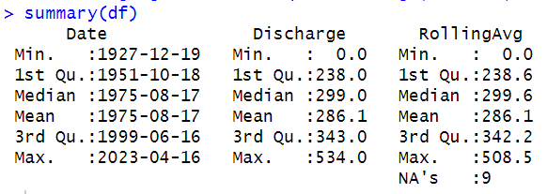
Rolling Average Comal Conti…

Slide 11
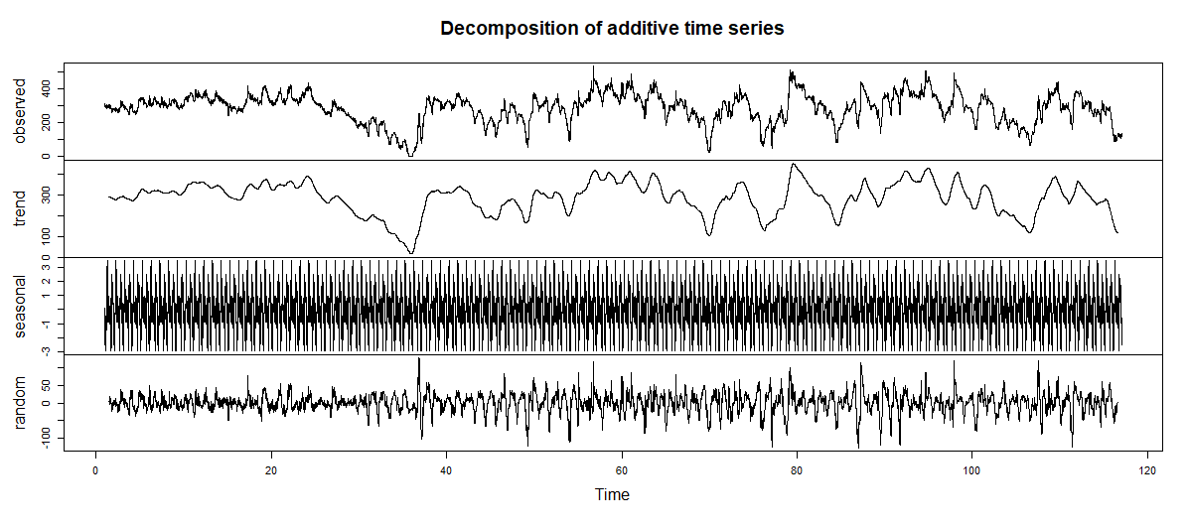
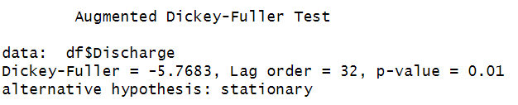
Decomposition and Test Comal Conti…

Slide 12
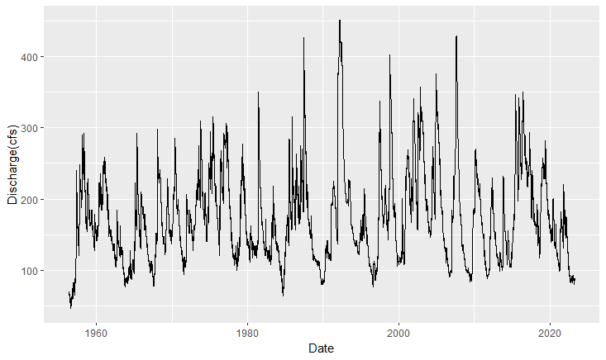
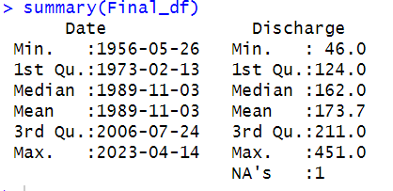
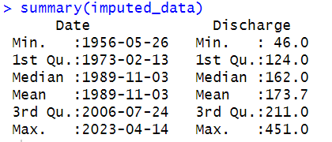
San Marcos Spring Discharge
Original dataset with missing values
Imputed dataset with extrapolated values

Slide 13
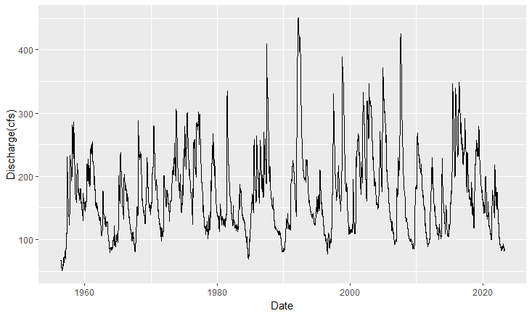
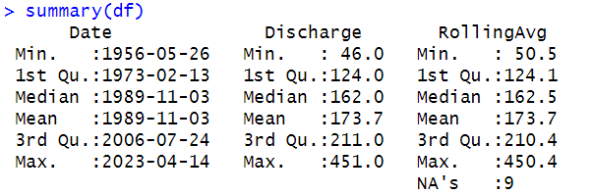
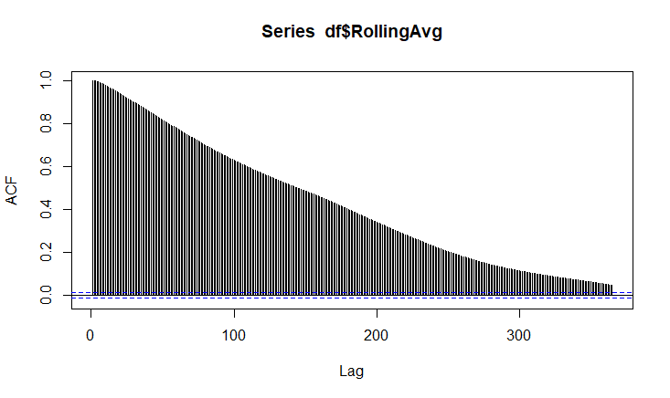
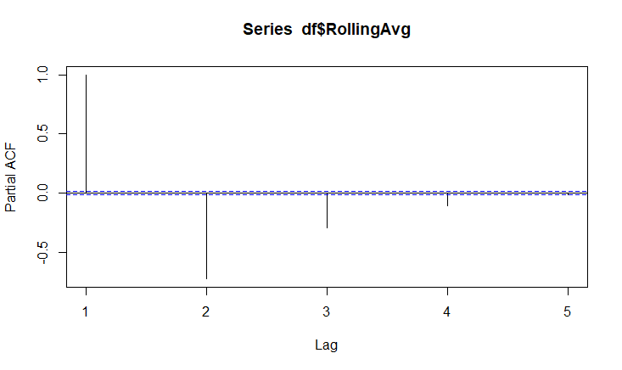
Rolling Average San Marcos Conti…

Slide 14
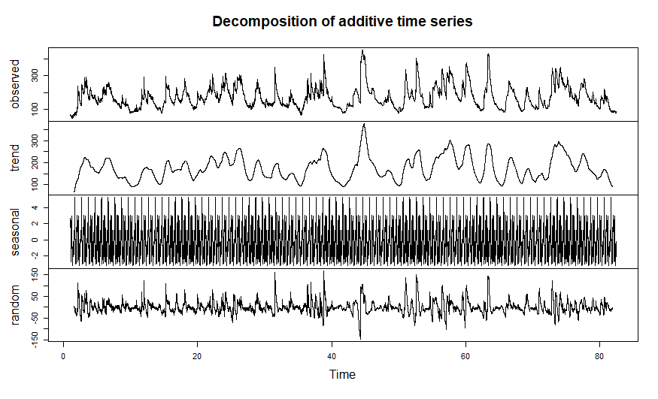
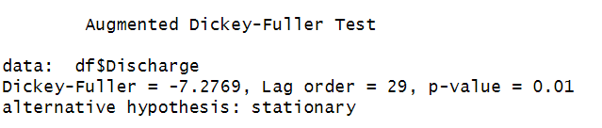
Decomposition and Test San Marcos Conti…

Slide 15
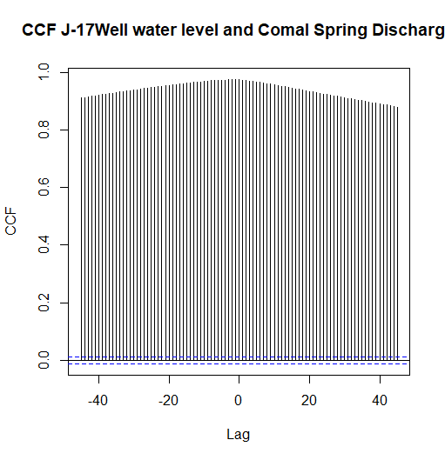
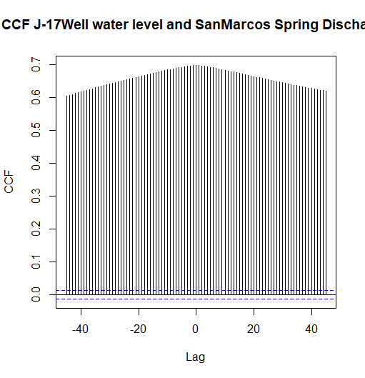
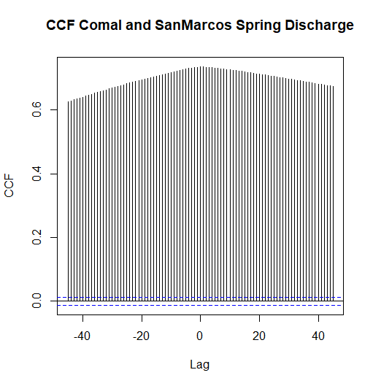
Cross Correlation (CCF)
How one dataset is related to other datasets
Useful for visualization of the data
Cross-correlation as function of lag time

Slide 16

Conclusion
Time series data analysis needed before time series Forecasting
For the analysis, some pre-processing of the data is required
Continuity of the data (Time series needs to be continuous in time domain)
Data imputation using filters (interpolation or model fitting with extrapolation)
Auto correlation and Partial Auto correlation present within the data
Cross correlation among the data
Data decomposition
Study of trends in the data (done using Mann Kendal)

Slide 17

THANK YOU

